Slide 1
Security presentation

Slide 2
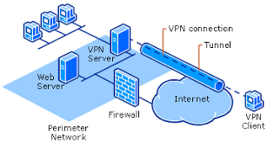
Identify and discuss the potential impact of incorrect configuration of some network security devices on IT security.

Slide 3
1-VPN
VPN (virtual private network): It is a service that gives privacy over the Internet by creating a private network that hides your Internet address (IP) so that no one can know what you can do online and offers VPN by creating an encrypted and secure connection that provides greater privacy than secure Wi-Fi.
Third-party VPN: (1-EDCO 2-JEPCO 3-Some customers.)
It is a service provided to third parties and it is only for those authorized to enter without controlling their devices. It allows them to access the network.
Notes:
--benefits of a VPN:
1-Stream from anywhere
2-Access blocked websites
3-Avoid censorship
4-Don’t be tracked

Slide 4
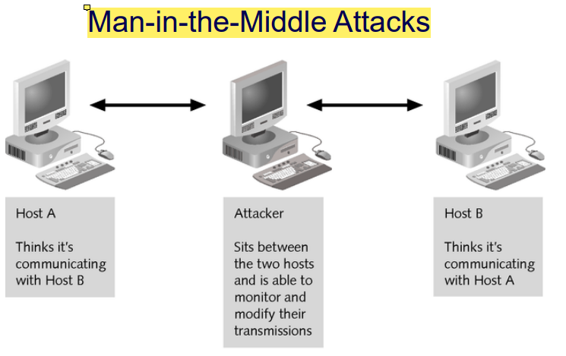
Impact on it security vpn
1- A man in the middle attack will occur.
2- The employees will not be able to work from their homes because data may be stolen while it is being transferred to the data center, or they may be eavesdropped.
3- corruption of transmitted data.
4- The encryption key that encrypts the data will be revealed during its transmission to the data center.
5- Information theft.
6- there will be risks to companies that have access to the organization's for example EDCO and JEPCO and some risk customer.
Notes:
-- How does Man-in-the-Middle Attacks happen?
The attacker captures the sensitive data sent to the data center and knows this data and then sends it to the data center or it is changed before it is sent.
-- How does corruption of transmitted data happen?
When the data is sent to the database, the attacker will destroy the data before it reaches it.
-- How does there will be risks to companies that have access to the organization's for example EDCO and JEPCO and some risk customer happen?
Because it may affect their security, a security breach may occur in order to obtain some information through misconfiguration on VPN.

Slide 5
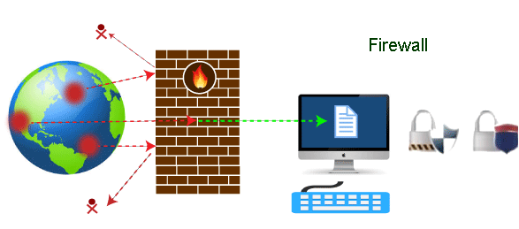
2-firewall
Firewall: It is a security device that monitors network traffic. Protects devices and files, prevents hacking, snooping and antivirus from attacking the network. It is one of the first lines of defense in network security. It is a barrier between internal and external networks. A firewall can be hardware or software.
Notes:
--benefits of a firewall:
1. Monitors Network Traffic
2. Stops Virus Attacks
3. Prevents Hacking
4. Stops Spyware
5. Promotes Privacy

Slide 6
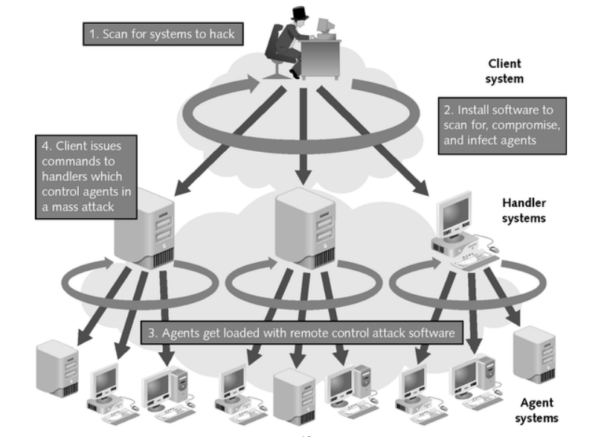
Impact on it security firewall
1- It may lead to data loss or theft
2- DDoS attack
3-attack on the database
4-corruption of transmitted data.
5-Malware attack
6- The encryption key that encrypts the data will be revealed during its transmission to the data center.
Notes:
-- How does DDoS attack happen? (distributed denial-of-service)
It attacks the devices connected to the network by botnets, tries to disrupt traffic, targets the organization's infrastructure, and sends malicious programs or viruses to the devices that lead to the loss of access to the organization's website.
--How does Malware attack happen?
Consists of software designed to break into devices and make a mess or destroy devices. like viruses.
--How does attack on the database happen?
The attacker will send viruses to the database and delete the data or change the information and find out the important information and the credit card information saved in the database can be stolen.

Slide 7
Implementing different techniques in network security (such as DMZ, static IP and NAT).

Slide 8
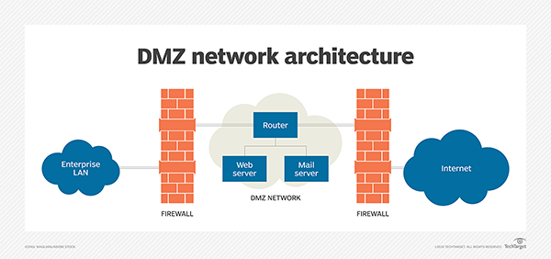
Demilitarized Zone )DMZ(
It is a sub-network that separates the local area network (LAN) from other untrusted networks, also known as scanned subnets. Within this network are servers and devices such as the web, e-mail and file transfer protocols that can be accessed from the Internet and provides an additional layer of security for the local network of the organization because it reduces the access of the attacker to servers and data If the attacker can bypass the DMZ, firewalls will prevent it from accessing the data.
how DMZ will enhance security ?
It will mainly help to protect the internal network and this is done by preventing the hackers from accessing and being used for sensitive and important data and will block all unreliable people from accessing the data.
What servers will be placed in the DMZ ?
Web server and mail server.
Notes:
What servers will be placed in the DMZ ?
1-A Web server that holds public information.
2-A mail server that relays outside mail to the inside.

Slide 9
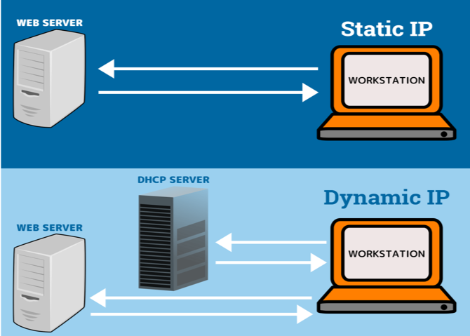
static IP
static IP :It is an address that does not change (permanent addresses) once the IP address is assigned to the devices, the IP address remains the same until the device is shut down or the network environment is changed. It is used for servers and devices. It is easier to set up and manage using DNS servers, and it is easier for employees to find each other via DNS and send Emails and Web Navigation.
how Static IP will enhance security ?
It is easy to hack and is always vulnerable to attack because the IP address does not change and therefore it is easy for hackers to penetrate because it knows the location of the organization’s server on the Internet, which causes financial losses and can help VPNs to hide the site.
What servers will used Static IP ?
Routers, printers, FTP servers, and DHCP servers.
Notes:
An IP address: is a unique number assigned to each device on the network that allows the devices to communicate with each other. It consists of 32 bits.

Slide 10
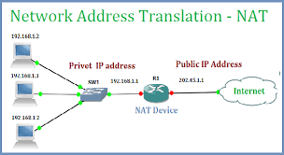
Network Address Translation )NAT(
A process by which a single unique IP address is represented by a group of computers or a single computer. A network device, which is a router or a firewall, assigns a public IP address within the private network and therefore acts as an intermediary between the local and private network. The goal of NAT is to maintain public IP addresses for protection.
how NAT will enhance security?
It will help to hide the IP addresses of the employees inside the network, but the firewall is the best way to hide the details of the internal network of the organization because NAT is not a firewall and it does nothing to stop the malicious traffic but when I have NAT and Firewall in the organization it will increase the security further.
What devices use NAT?
Firewall and router.

Slide 11
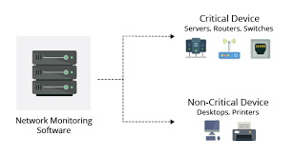
Network Monitoring Systems
Network monitoring systems: a subset of network management that includes hardware and software tools, a process by which a network is discovered and monitored to report any hardware failures to ensure optimal performance and ensure that everything is running efficiently. For example: traffic jams that limit data flow.
Notes:
Network Monitoring Systems provide five basic functions:
1-Discover: Find the Devices on Your Network.
2-Map: Visualize Your Network.
3.Monitor: Keep an Eye on Your Network.
4.Alert: Get Notified When Devices Go Down.

Slide 12
benefits of Network Monitoring Systems:
1-Benchmarking standard performance
2-Effectively allocating resources
3-Managing a changing IT environment
4-Identifying security threats
5-Deploying new technology and system upgrades successfully
6-Address Network Problems Faster
7-Save a lot of money
Notes:
1-Benchmarking standard performance: When network performance is measured on a daily basis to catch any changes in performance, which determines cases before they occur to identify them early and correct errors before they cause a system failure.
2-Effectively allocating resources: When the source where the problem occurred is known, the technical teams will be able to troubleshoot and develop measures and standards to ensure business continuity.
3-Managing a changing IT environment: Technology is always working on innovation and development and to be faster to gain security and provide technical teams with information about the devices and analyze all the methods that will be taken and reduce expenses on the organization.
4-Identifying security threats: It will help the organization in being able to protect data and systems, and any threat on the network will be detected and the damage that will affect the organization will be minimized.
5-Deploying new technology and system upgrades successfully: When monitoring the network, the organization can see the performance of the equipment and using the analysis it will be able to determine if the organization needs to expand its scope for business needs or buy new equipment for protection.
6-Address Network Problems Faster: When the network is down, there will be a delay in the processing of the network, so the monitoring can find problems and fix them quickly, and thus the business will continue without wasting more time.
7-Save a lot of money: The organization will save a lot of money because it does not need additional workers to monitor the network, as well as because it detects errors before any risks occur and fixes them.

Slide 13
justification of using
There are many reasons why the organization uses the network monitoring system, including improving network performance, exploring weaknesses and network slow problems and fixing them before any data risks occur, and it does this on an ongoing basis and helps the organization develop faster, expands its goals, and helps business continue without interruption for periods long.

Slide 14
Evaluating a minimum of three of physical and three virtual security measures that can be employed to ensure the integrity of IT security.

Slide 15
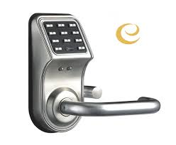
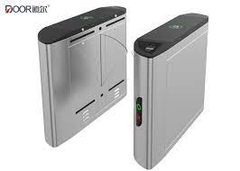
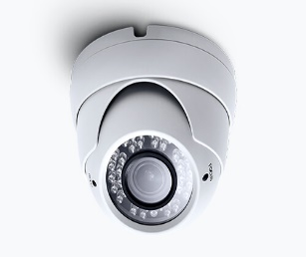

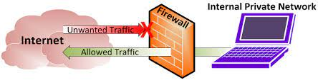
three of physical of IT security
Physical security is the protection of people, devices, software, networks, and data from physical actions and events that may cause loss or damage to an organization.
1- Putting a security door in the data center room the door is opened by a smart card or password.
2- Placing security device at the gate of the organization.
3- Installing CCTV cameras.
4- Providing the necessary safety tools in emergency situations.
5- Sitting the firewall on the network.
Notes:
--What is the reason for Putting a security door in the data center room the door is opened by a smart card or password?
In order to allow only authorized persons to enter the room and prevent any unauthorized person from entering to reduce the risks that may occur on devices from trying to destroy and data loss. So, it will greatly help to protect the data.
--What is the reason for Placing security device at the gate of the organization?
In order to search people who enter the organization and prevent them from entering anything that may cause harm to the organization in order to protect the equipment and employees. So, it will greatly help to protect devices in the organization. When the device beeps, the policeman searches the person and asks the person to enter again through the device to make sure that there is nothing else with him.
--What is the reason for Installing CCTV cameras?
Because of the monitoring of the employees who work within the organization, which makes the employees afraid of trying to create chaos inside the building, because they will go back to the cameras and be punished if they do anything to the contrary. So, it will greatly help to protect devices in the organization.
--What is the reason for Providing the necessary safety tools in emergency situations?
because providing the necessary protection, such as fire alarms, extinguishers and emergency exit doors, it helps reduce risks on devices and people. so, it will provide safety and protection.
-- What is the reason for Sitting the firewall on the network?
It prevents unauthorized outgoing and incoming access to the organization's internet networks. This is done by examining the traffic if it is in violation of the traffic inside the device. It rejects it and does not allow its passage to the network because it is against the traffic. So, it will greatly help to protect devices in the organization.

Slide 16
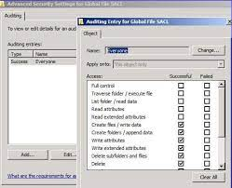
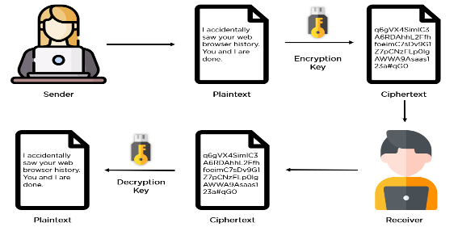
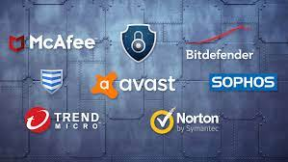
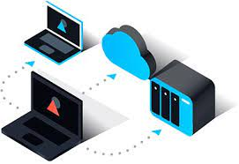
three virtual measures security of IT
Virtual security: Measures, procedures and processes that ensure the protection of the infrastructure or virtual environment. It addresses the security issues faced by the components of a virtualization environment and the ways in which they can be mitigated or prevented.
1- List access control to files.
2- Encryption of the data being transmitted.
3- install antivirus software on all devices.
4- Backup for data for security and save the data.
Notes:
-- What is the reason for list access control to files?
Due to the provision of the necessary protection for the data and ensuring that the data remains confidential and allowing only certain people who can access to modify or delete files within the authorized scope and cannot bypass any instructions that have been directed to him, measures will be taken to punish him and thus reduce the risk of data exposure.
-- What is the reason for Encryption of the data being transmitted?
Because of preventing anyone from trying to hack the data and knowing its content while it is being transferred from wind farms or energy or while it is being transferred from the employee to the data center and so will maintain the confidentiality of the data.
-- What is the reason for install antivirus software?
Because of reducing viruses that will disrupt the performance of the device or delete data, and therefore anti-virus programs prevent these viruses from trying to penetrate the device. so, it will help to keep the device safe.
-- What is the reason for Backup for data?
Because in the event of a loss of data or an attack and he deletes all the data that was stored inside the database, all the data that was backed up will be returned, because the backup provides the necessary security for the data and prevents anyone from trying to access it. So it will provide complete data security.

Slide 17
The end presentation
Notes:
References:-
1-vpn: https://www.googleadservices.com/pagead/aclk?sa=L&ai=DChcSEwi3hpW7tsP1AhXHse0KHVAmCocYABAAGgJkZw&ae=2&ohost=www.google.com&cid=CAESP-D23c2tnbb6n16ogzOQHfOaadYoY5CjcRA32o76ulj9MvJPVWrDH9HRihviQoFFQC-ZGKVbLkTVprdk2ltDnQ&sig=AOD64_2II2ld6PL1wxlkNkzxviJ5-Xvwqw&q&adurl&ved=2ahUKEwir1Yu7tsP1AhVShlwKHQjwAC8Q0Qx6BAgDEAE
2-firewall: https://www.cisco.com/c/en/us/products/security/firewalls/what-is-a-firewall.html
3-dmz: https://www.fortinet.com/resources/cyberglossary/what-is-dmz
4-static ip: https://whatismyipaddress.com/dynamic-static
5-nat: https://www.comptia.org/content/guides/what-is-network-address-translation
6-network monitoring system: https://www.cisco.com/c/en/us/solutions/automation/what-is-network-monitoring.html

